Slide 1
SEND Information Report 2023-2024
Taking pride and achievement in learning

Slide 2
At Assess Education, our vision is to ensure that no child is left behind by promoting a focus on academic, emotional, behavioral and social support to prepare our students for adult life. We believe in making a difference to all students through taking pride in learning to become the best they can be.
What types of SEN do we provide for? | Assess Education welcomes all students and provides for a range of identified needs including Communication and Interaction; Cognition and Learning; Social, Emotional and Mental Health and Sensory difficulties. We understand that children identified as having special educational needs (SEND) have a significantly greater difficulty in learning than most children the same age which prevents and/or hinders from making use of educational facilities that are generally provided for students of similar ages in schools locally (SEND Code Of Practice, 2015). At Assess Education we keep registers of students who have special educational needs and disabilities (SEND) and additional needs. Students with significantly greater difficulty in learning are recorded on the SEND Register. The Additional Needs Register is for students who can access mainstream curriculums but have an additional need.
How do we identify and assess students with SEN? | Most students with SEN have undergone formal assessments or diagnoses at primary school. Throughout the transitional process, we ensure all relevant information is passed on from previous schools and the relevant authorities, so we are fully aware of students’ requirements before arriving at Assess Education. We will carry out detailed individual assessments for each students at the earliest opportunity to create an accurate image of assessment levels and educational needs including: Reading and spelling standardised assessments Baseline English and Maths assessments Our staff closely monitor the progress and attainment of all students, including those who have/may have SEN. We continuously monitor students during their time at Assess Education and can further identify students with special educational need. In line with SEND Code Of Practice (2014), We follow a graduated approach to identifying and assessing individual need through ‘Assess, Plan, Do, Review model (Assess a student’s special educational needs; Plan the provision to meet the student’s aspirations and agreed outcomes; Do – put the provisions in place to meet those outcomes; Review the support and progress).
Taking pride and achievement in learning

Slide 3
Assess
Close liaison with families and previous schools
Assessments on entry
Continuous, close monitoring of progress
Referrals made to SENCo
Referrals to external agencies where required
Review
Review meetings for ASPs, EHCPs and PFAs
Termly meetings with parents
Meetings with students
Close monitoring of progress/tracking
Assess
Review
The Graduated Approach
Plan
Do
Quality teaching
Personalised, innovative provision
Targeted intervention
Plan
Student-centered planning
Learner profiles
Additional support plans (ASP)
Education, Health and Care Plan (EHCP)
Pupil Funding Agreement (PFA)
Lesson / Intervention planning
Do
Taking pride and achievement in learning

Slide 4
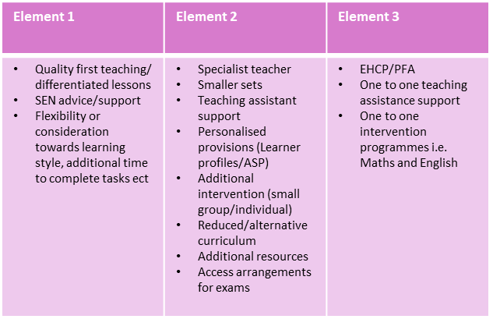
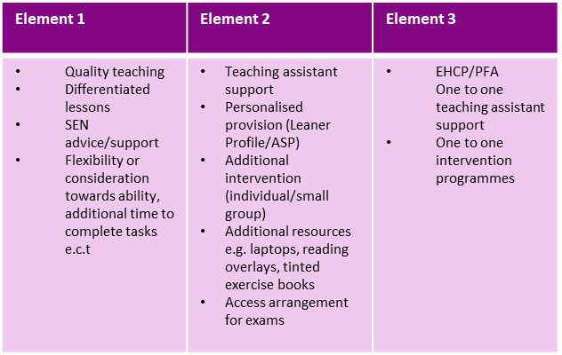
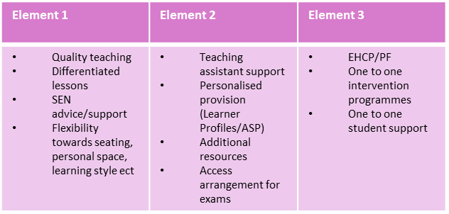
What types of SEN do we provide for? | At Assess Education, we are committed to providing high-quality, tailored and innovative teaching to meet the needs of all students. Teachers plan for students with SEN using personalised practices (focusing on students and family viewpoints and short/long-term goals) to write Learner Profiles (Appendix 2). Students’ Learner Profiles give staff an overview of students’ strengths as well as needs and guidance on how best to support them in the school environment. We ensure all students’ needs are met using Element 1 funding (for all students), Element 2 funding (for students with special educational needs) and Element 3 funding (for students with high needs):
Social, Emotional and Mental Health difficulties
Cognition and Learning
Element 1 | Element 2 | Element 3
Whole school behaviour policy, rewards and consequences system PSRE for all Student Service support from all staff Access to school nurse Quality first teaching/Differentiated lessons SEN advice/support Flexibility or consideration towards learning style | Teaching assistant support Personalised provision (Leaner Profile/ASP) Additional intervention (individual/small group) Referral to outside agencies where required e.g. CAMHS | EHCP/PFA One to One Teaching assistant support One to One intervention programme
Sensory needs
Communication and Interaction

Slide 5
 | There are 4 teaching assistants in Assess Education, who support students in class, in small groups and individually. The teaching assistants are committed to offering high quality support in lessons. They work in collaboration with the teachers to support students’ learning, primarily supporting students who have special educational needs.
Who is our special education needs Co-Ordinator (SENCO) and how can she be contacted? | Sophie Bennett SEN Leader Assess Education 187-193 Picton Road, Wavertree, Liverpool L15 4LG 0151 735 0036 reception@assesseducation.co.uk
How will I know how my child is doing and how will you help me to support my child’s learning? | At Assess Education, we value highly our relationships with parents and recognise the importance of collaboration between home and school. All students at Assess Education will receive a Progress Update Report each term and parents will have the opportunity to meet staff if desired. Through these meetings, information will be shared and distributed, for example, Learner Profile, Additional Support Plan guidance on how to access additional support
What support will there be for my child’s overall well-being | All students are supported by staff, who will closely monitor each student’s well-being. Some students benefit from additional support and this can be offered from: Designated Safeguarding Lead: Gail Robinson Deputy Designated Safeguarding Lead: Kayleigh Riddell Learning Support Leader: Sophie Bennett Pastoral: Gail Robinson Attendance Officer: Margie Roseby All students on the SEN register will have dedicated one to one tutorials with the Pastoral leader to contribute to their Learner Profile (Gail Robinson). They also can discuss their special needs and provision in school and voice any concerns they may have.
Taking pride and achievement in learning

Slide 6
What specialist services and expertise are available at or accessed by the school? | The Learning Support Department supports students who have any kind of additional learning or health need. The SENCo works closely with a wide range of professional and agencies to ensure students are well-supported, including: Speech and Language Therapy Service Health Professionals ADHD Foundation Child and Adolescent Mental Health Services Parents can also find additional information about specialist services through Liverpool’s Local Offer.
What training are the staff supporting children and young people with SEN had or are having? | All staff have had safeguarding training and this is frequently repeated. The SEN leader, Sophie Bennett provides further guidance for staff on how best to meet the needs of students with SEN. Sophie is an experience SEN teacher and continues to undergo further training to increase her knowledge to continue to provide excellent support to students. Our staff have been trained in positive behaviour strategies. Assess Education have a wide range of specialist knowledge on how to support students with learning difficulties and English as an Additional Language.
How will my child be included in activities outside the classroom including school trips? | Assess Education is an inclusive school. We endeavour to ensure all students can access outdoor activities, extra-curricular activities and trips by considering needs on an individual basis. At Assess Education, we believe in the importance of recognising and developing students’ individual strengths as well as supporting identified needs.
How accessible is the school environment | Assess Education is a Disability and Discrimination Act (DDA) compliant school, which means we cater for disabilities by way of access, fire evacuation and welfare facilities. For further information, contact our Health and Safety governor Steven Marsden, (0151 735 0036 / reception@assesseducation.co.uk). For further information please refer to our Accessibility Policy on the school website or contact our Health and Safety governor.
Taking pride and achievement in learning

Slide 7
How will the school prepare and support my child when joining Assess Education or transferring to a new school? | The Pastoral and SEN leaders will contact each previous school to meet and gather information about all new students. In addition, they will meet students and their families through the school’s induction programme. New starters all follow the induction programme. For students with high needs, they will work closely with the students and their family to ensure a successful transition to high school. Some students will be chosen for the ‘Catch-up’ curriculum, based on recommendations and assessment from previous educational settings, assessment on entry and at the request of parents. These students will follow a very similar curriculum to other students but will often be taught in smaller classes with teaching assistant support. As part of our commitment to preparing students for adulthood we offer a variety of opportunities to enable students to make positive choices relating to their future. All students follow the Assess Pathway to Success, which aims to deliver a wide range of activities that inform and prepare students for their future pathways and careers. All students are supported to find the most appropriate post-16 provision to support their future ambitions. Students with SEN are given additional support to ensure the transition is a success, for example, accompanied visits to collages, meetings with college tutors.
How will I be involved in discussions about and planning for my child’s education? | Parents are also given the opportunity to provide feedback to Assess Education through our open-door policy. We make it clear that our students are at the heart of every decision we make and thereby are highly interested in parents' views. Our staff are very open, supportive and interested in students and parents/guardians' viewpoints. We also welcome parents to our parents evening where communications surrounding planning for education can be discussed.
Taking pride and achievement in learning

